Slide 1

حلقة بحث
جامعة حلب
كلية الهندسة الكهربائية والالكترونية
قسم الآلات و القيادة الكهربائية
السنة الثالثة
d.c. Machines
إشراف الطالب
إعداد الطالب
رودين فقيه
ريزان منلا محمد

Slide 2
Principle Of Operation Of A d.c. Machine
All motors and generators make use of two basic principles:
  When two poles of a magnet are brought close together then there will be either a repulsion force or an attraction force
  When current flows in a conductor, a magnetic field is created around that conductor

Slide 3
Bar Magnet
N S
Lines of Flux
Flux Density =
# of Flux Lines / per unit area

Slide 4
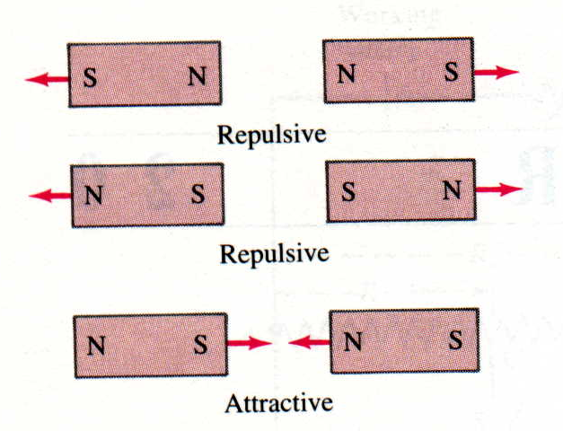
Magnetism
Opposites Attract / Likes Repel
Instructor:
With magnetic fields, opposite poles attract and like poles repel.

Slide 5
Current Carrying Conductor
Conductor
Lines of Flux
Current Flow

Slide 6
Electromagnetic Coil
Flux Density
Dependant on:
Current
# of Coils
Core Material
Lines of Flux

Slide 7
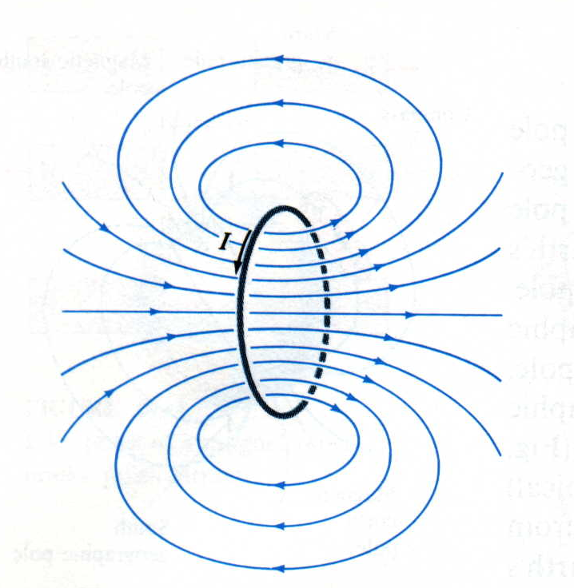
Electromagnetism
Instructor:
The same current loop as before, with the magnetic field shown. The looping current creates a magnetic field that is much stronger through the center of the loop than outside the loop. The field in the middle of the loop also approximates a straight line. The current loop acts as an electromagnet. When the current through the loop stops, the magnetic field disappears.

Slide 8
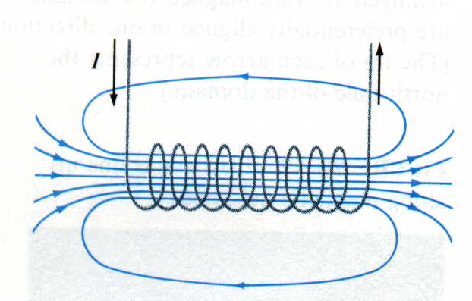
Electromagnet
Instructor:
If the many current loops are put together in a coil, the magnetic field strength increases, creating an even more powerful current-controlled magnetic field.
s N

Slide 9
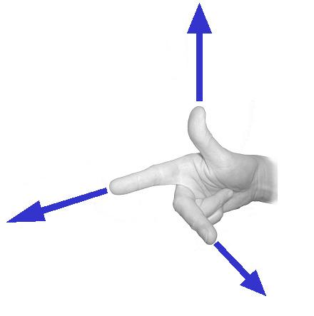
Right Hand Rule # 2
Electric Currents & Magnetism → Force
Force
Current
Magnetic Field

Slide 10
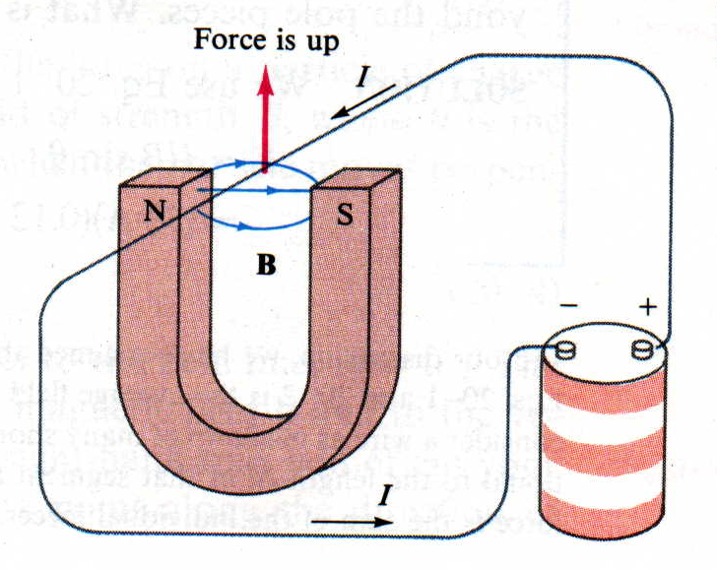
Force in a Conductor

Slide 11
Instructor:
When only the current flow is reversed (by reversing the polarity of the battery, in this example), the force reverses direction and now goes up.

Slide 12
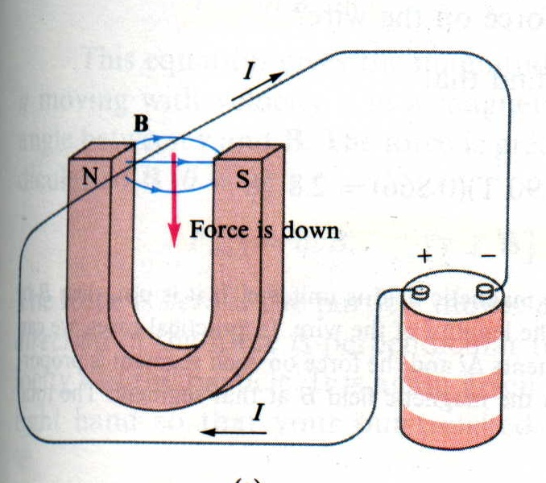
Force in a Conductor

Slide 13
Instructor:
As seen previously with the bar magnets, magnetic fields that come near each other create a force. In the example shown, the current is flowing through a wire that passes through a horseshoe magnet. The magnetic field from the horseshoe magnet interacts with the wire current, causing a downward force on the wire.
Note: Another right-hand rule can be used to remember the direction of the interacting forces. The index finger points in the same direction of the current flow, the middle finger is perpendicular to the index finger and points in the direction of the magnetic field, and the thumb (pointing perpendicular to both the index and middle fingers) points in the direction of the resulting force.

Slide 14
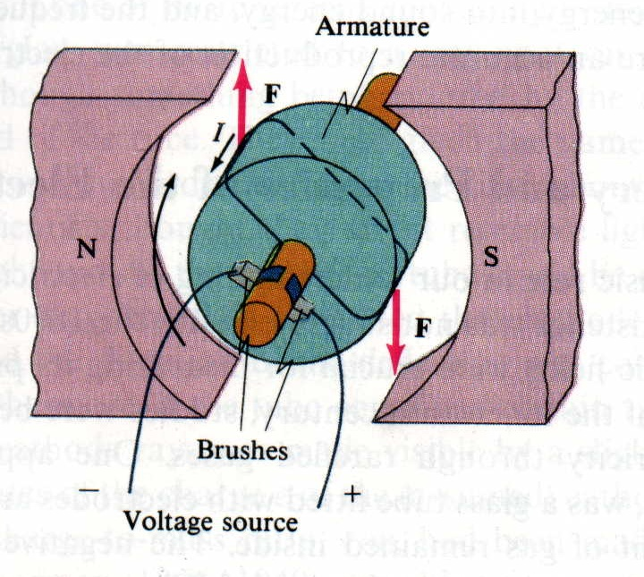
Diagram of a Simple DC Motor

Slide 15
Instructor:
The DC motor utilizes this concept by changing the direction of the current flowing through the brushes into the coiled wire in the armature. A permanent magnet creates a constant magnetic field, and when current runs through the coils, a force is created that turns the armature. When the armature has turned far enough, the brushes are now in contact with the opposite ends of the coiled wire, effectively reversing the polarity of the voltage across the coil and reversing the current flow, which create a force that spins the armature further in the same direction. This process repeats as long as voltage is supplied to the motor, creating the motor rotational force.

Slide 16
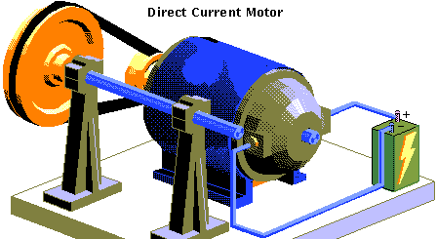
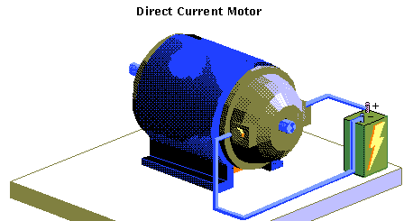
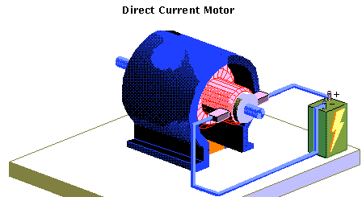
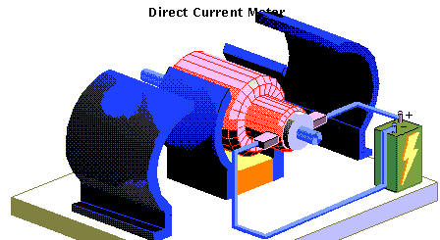
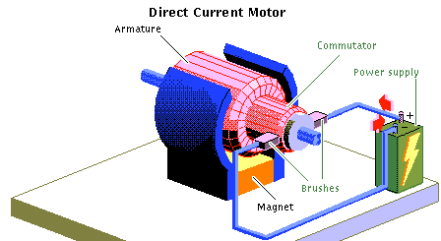
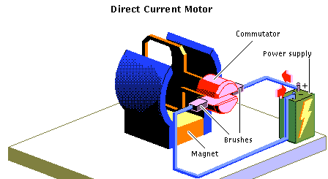
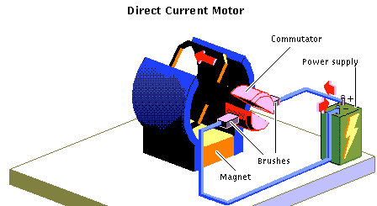
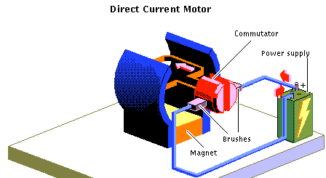
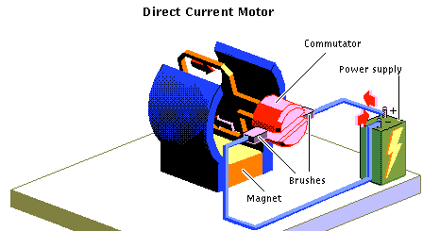
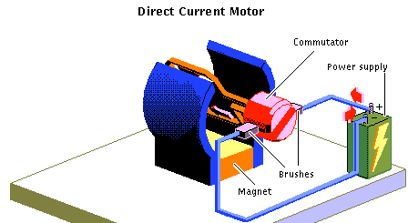
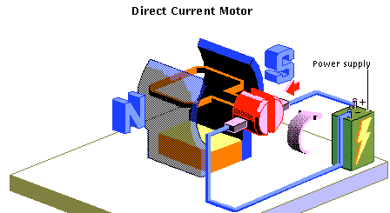
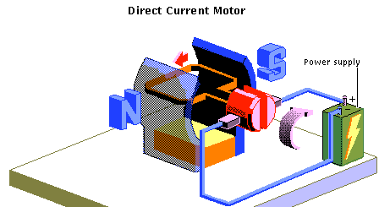
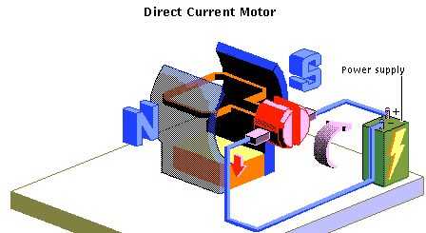

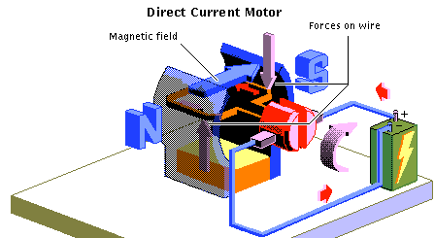
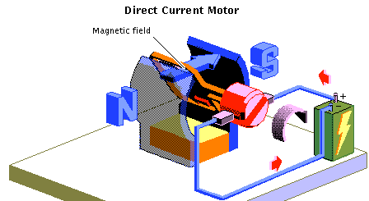
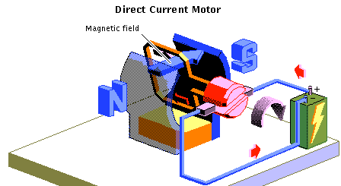
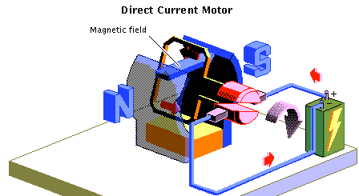
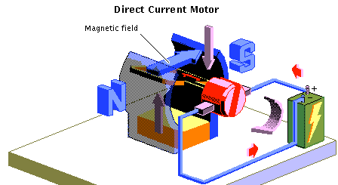
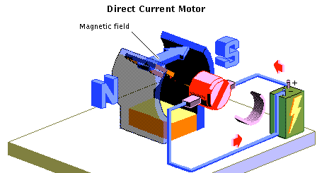
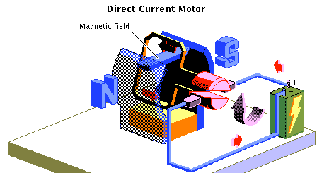
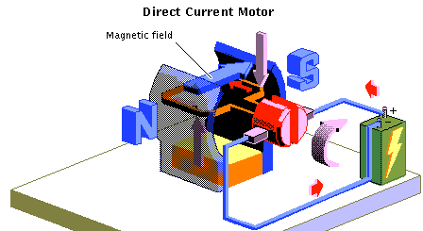
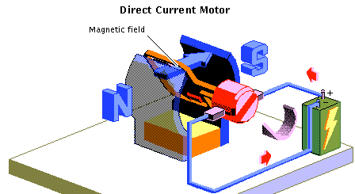

Electric Motor

Slide 17
Instructor:
This is a detailed animation of the operation of a DC motor, showing the forces, current flow, and resulting motion caused by the magnetic fields.

Slide 18
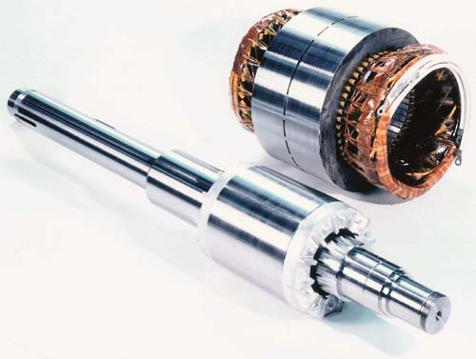
Motor Construction
Stator Laminations
Stator Winding Assembly
Die-cast Rotor Assembly
Motor Shaft

Slide 19
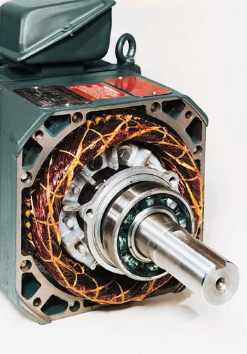
MOTOR CONSTRUCTION
Motor Frame Assembly
Rotor
Assembly
Stator Winding Assembly

Slide 20
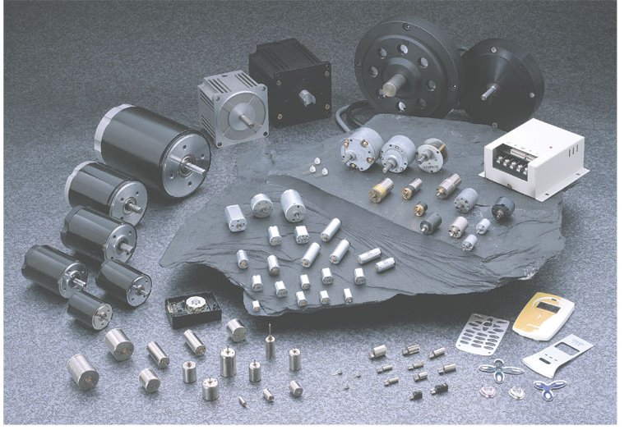
Simple DC Motor

Slide 21
CLASSIFICATION OF DC MACHINES
Several possible connections for field and armature circuits
- classification of DC machines is determined by the way
they are connected
Separately excited dc machine
+
E_{a}
₋

Slide 22
CLASSIFICATION OF DC MACHINES
Shunt dc machine
+
E_{a}
₋

Slide 23
CLASSIFICATION OF DC MACHINES
Series dc machine
+
E_{a}
₋

Slide 24
الفرق بين المحركات المستمرة التفرعية و التسلسليه
المحركات التفرعية | المحركات التسلسلية
يمكن تشغيل المحرك التفرعي بدون حمل | لا يمكن تشغيله بدون حمل بسبب زيادة السرعة المستمرة
عزم أقلاع صغير. | عزم أقلاع كبير بسبب اجتماع سيالة الدائر مع الأقطاب معا
تيار أقلاع بدون حمل صغير | تيار أقلاع المحرك بدون حمل كبير بسبب مقاومة صغيره
مقاومة الملفات الأقطاب كبيره | مقاومة ملفات الأقطاب صغيره
سرعة تقريبا ثابتة عند الحمل | سرعة متغيره مع تغير الحمل(تنقص السرعة)
التحكم بسرعة 1-ملفات الأقطاب 2-ملفات الدائر | التحكم بسرعة 1-مقاومة تسلسلية مع الدائر 2-مقاومة تفرعية مع الأقطاب
تستخدم في الاماكن التي تتطلب سرعة دوران ثابتة مثل المثاقب والمخارط والمطاحن والروافع | تستخدم ايضا في الروافع والمصاعد والمناجم وحافرات الآبار النفطية

Slide 25
المحركات التفرعية | المحركات التسلسلية
عند زيادة العزمT يزداد تيار الدائر Ia | العلاقة بين السرعة مع تيار الدائر علاقة عكسية
عند زيادة العزم T تتناقص السرعة N | العلاقة بين السرعة مع العزم علاقة عكسية
عند زيادة توتر الدائر تزداد السرعة N | العلاقة بين العزم مع تيار الدائر علاقة طردية
عند زيادة تيار الدائر تتناقص السرعة N | العلاقة بين السرعة مع تيار الأقطاب علاقة عكسية
 | العلاقة بين السرعة مع التوتر علاقة طردية
 | العلاقة بين التوتر مع العزم علاقة عكسية

Slide 26
CLASSIFICATION OF DC MACHINES
Compound dc machine - short shunt
+
E_{a}
₋

Slide 27
CLASSIFICATION OF DC MACHINES
Compound dc machine – long shunt
+
E_{a}
₋

Slide 28
DC GENERATORS
Electrical input
Mechanical output
ELECTRICAL
MACHINES
- Motor -
Electrical output
Mechanical input
ELECTRICAL
MACHINES
- Generator -

Slide 29
DC GENERATORS
Separately excited DC generator
+
E_{a}
₋

Slide 30
DC GENERATORS
Separately excited DC generator
R_{a}
L_{a}
+
v_{f}
₋
L_{f}
R_{fc}
+
E_{a}
₋
+
V_{t}
₋
R_{L}
R_{fw}
L_{f} - Field winding inductance
R_{a} – Armature winding resistance
L_{a} - Armature winding inductance
R_{fc} – External field resistance
R_{L} – External Load
R_{fw} – Field winding resistance

Slide 31
DC GENERATORS
Separately excited DC generator
R_{a}
L_{a}
+
v_{f}
₋
L_{f}
R_{fc}
+
E_{a}
₋
+
V_{t}
₋
R_{L}
R_{fw}
Under steady state condition L_{f} and L_{a} can be ‘removed’

Slide 32
DC GENERATORS
Separately excited DC generator
R_{a}
+
v_{f}
₋
R_{fc}
+
E_{a}
₋
+
V_{t}
₋
R_{L}
R_{fw}
Under steady state condition L_{f} and L_{a} can be ‘removed’ from the circuit

Slide 33
DC GENERATORS
Separately excited DC generator
I_{f}
R_{a}
I_{a}
I_{t}
+
v_{f}
₋
R_{fc}
+
E_{a}
₋
+
V_{t}
₋
R_{L}
R_{fw}
V_{f} = (R_{fc} + R_{fw})I_{f}
E_{a} = I_{a}R_{a} + V_{t}
E_{a} = K_{a} Φ ω_{m}
V_{t} = I_{a} R_{L ,} also I_{t} = I_{a}

Slide 34
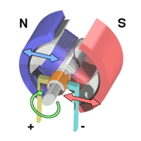
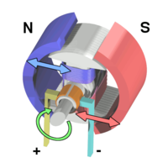
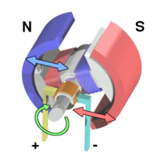
How It Works
When electric current passes through a coil in a magnetic field, the magnetic force produces a torque which turns the motor.
Force in Motor:
F=ILB
F = Force
B = Magnetic Field
L = Length of Conductor
I = Current in Conductor
Torque in Motor:
T = IBA sin θ
A = LW
L = Length of Winding
W = Width of Winding
Images courtesy of Wikipedia
(http://en.wikipedia.org/wiki/Electric_motor)

Slide 35
A simple DC electric motor. When the coil is powered, a magnetic field is generated around the armature. The left side of the armature is pushed away from the left magnet and drawn toward the right, causing rotation.
The armature continues to rotate.
When the armature becomes horizontally aligned, the commutator reverses the direction of current through the coil, reversing the magnetic field. The process then repeats.

Slide 36
Brushless DC Motor
No Commutators
Position of Coils with respect to the magnetic field is sensed electronically.
Current is commutated through electronic switches to appropriate phases.

Slide 37
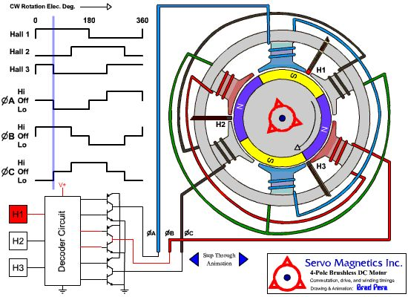
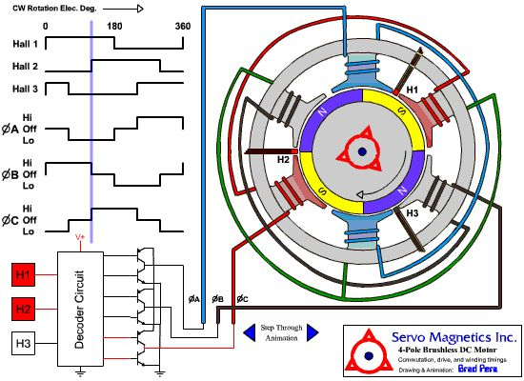
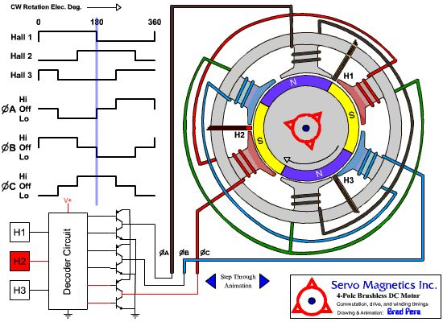
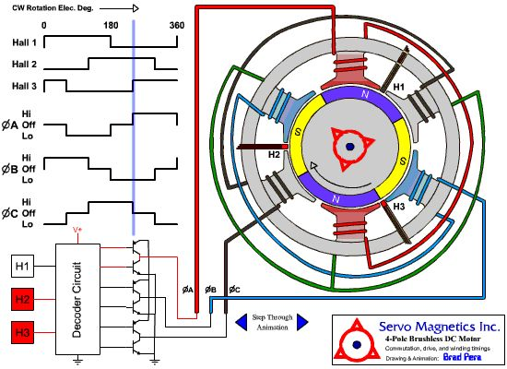
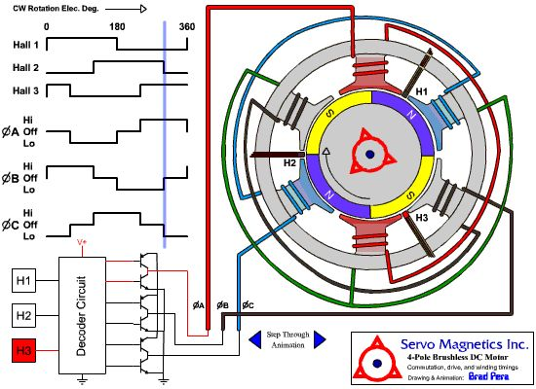
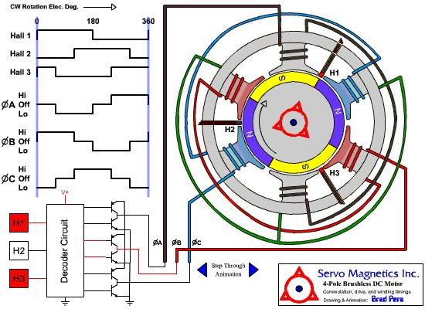
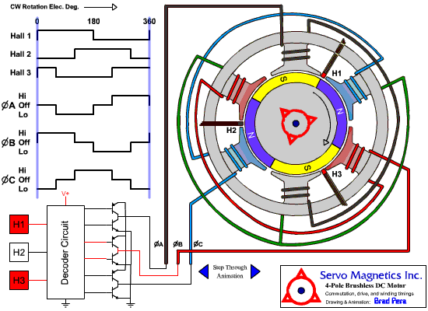
How it Works
Halls Sensors sense the position of the coils
The Decoder Circuit turns appropriate switches on and off
The voltage through the specific coils turns the motor
Images courtesy of Servo Magnetics
(http://www.servomag.com/flash/2-pole/2pole-bldc-motor.html)

Slide 38
DC Motors
A DC motor is designed to run on DC electric power. Two examples of pure DC designs are Michael Faraday's homopolar motor (which is uncommon), and the ball bearing motor, which is (so far) a novelty. By far the most common DC motor types are the brushed and brushless types, which use internal and external commutation respectively to create an oscillating AC current from the DC source—so they are not purely DC machines in a strict sense

Slide 39
Brushed DC motors
Main article: Brushed DC electric motor
The classic DC motor design generates an oscillating current in a wound rotor, or armature, with a split ring commutator, and either a wound or permanent magnet stator. A rotor consists of one or more coils of wire wound around a core on a shaft; an electrical power source is connected to the rotor coil through the commutator and its brushes, causing current to flow in it, producing electromagnetism. The commutator causes the current in the coils to be switched as the rotor turns, keeping the magnetic poles of the rotor from ever fully aligning with the magnetic poles of the stator field, so that the rotor never stops (like a compass needle does) but rather keeps rotating indefinitely (as long as power is applied and is sufficient for the motor to overcome the shaft torque load and internal losses due to friction, etc

Slide 40
Many of the limitations of the classic commutator DC motor are due to the need for brushes to press against the commutator. This creates friction. At higher speeds, brushes have increasing difficulty in maintaining contact. Brushes may bounce off the irregularities in the commutator surface, creating sparks. (Sparks are also created inevitably by the brushes making and breaking circuits through the rotor coils as the brushes cross the insulating gaps between commutator sections. Depending on the commutator design, this may include the brushes shorting together adjacent sections—and hence coil ends—momentarily while crossing the gaps. Furthermore, the inductance of the rotor coils causes the voltage across each to rise when its circuit is opened, increasing the sparking of the brushes.) This sparking limits the maximum speed of the machine, as too-rapid sparking will overheat, erode, or even melt the commutator. The current density per unit area of the brushes, in combination with theirresistivity, limits the output of the motor.

Slide 41
The making and breaking of electric contact also causes electrical noise, and the sparks additionally cause RFI. Brushes eventually wear out and require replacement, and the commutator itself is subject to wear and maintenance (on larger motors) or replacement (on small motors). The commutator assembly on a large machine is a costly element, requiring precision assembly of many parts. On small motors, the commutator is usually permanently integrated into the rotor, so replacing it usually requires replacing the whole rotor.

Slide 42
Large brushes are desired for a larger brush contact area to maximize motor output, but small brushes are desired for low mass to maximize the speed at which the motor can run without the brushes excessively bouncing and sparking (comparable to the problem of "valve float" in internal combustion engines). (Small brushes are also desirable for lower cost.) Stiffer brush springs can also be used to make brushes of a given mass work at a higher speed, but at the cost of greater friction losses (lower efficiency) and accelerated brush and commutator wear. Therefore, DC motor brush design entails a trade-off between output power, speed, and efficiency/wear.

Slide 43
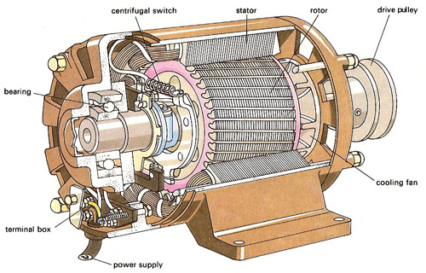

Slide 44
A: shunt
B: series
C: compound
f = field coil
There are five types of brushed DC motor:
A. DC shunt wound motor
B. DC series wound motor
C. DC compound motor (two configurations):
Cumulative compound
Differentially compounded
D. Permanent Magnet DC Motor (not shown)
E. Separately-excited (sepex)(not shown).

Slide 45
Brushless DC motors
Main article: Brushless DC electric motor
Some of the problems of the brushed DC motor are eliminated in the brushless design. In this motor, the mechanical "rotating switch" or commutator/brushgear assembly is replaced by an external electronic switch synchronised to the rotor's position. Brushless motors are typically 85-90% efficient or more (higher efficiency for a brushless electric motor of up to 96.5% were reported by researchers at the Tokai University in Japan in 2009),^{[16]} whereas DC motors with brushgear are typically 75-80% efficient.
Midway between ordinary DC motors and stepper motors lies the realm of the brushless DC motor. Built in a fashion very similar to stepper motors, these often use a permanent magnet external rotor, three phases of driving coils, one or more Hall effect sensors to sense the position of the rotor, and the associated drive electronics.

Slide 46
The coils are activated, one phase after the other, by the drive electronics as cued by the signals from either Hall effect sensors or from the back EMF (electromotive force) of the undriven coils. In effect, they act as three-phase synchronous motors containing their own variable-frequency drive electronics. A specialized class of brushless DC motor controllers utilizes EMF feedback through the main phase connections instead of Hall effects sensors to determine position and velocity. These motors are used extensively in electric radio-controlled vehicles. When configured with the magnets on the outside, these are referred to by modellers as outrunner motors.
Brushless DC motors are commonly used where precise speed control is necessary, as in computer disk drives or in video cassette recorders, the spindles within CD, CD-ROM (etc.) drives, and mechanisms within office products such as fans, laser printers and photocopiers.

Slide 47
They have several advantages over conventional motors:
Compared to AC fans using shaded-pole motors, they are very efficient, running much cooler than the equivalent AC motors. This cool operation leads to much-improved life of the fan's bearings.
Without a commutator to wear out, the life of a DC brushless motor can be significantly longer compared to a DC motor using brushes and a commutator. Commutation also tends to cause a great deal of electrical and RF noise; without a commutator or brushes, a brushless motor may be used in electrically sensitive devices like audio equipment or computers.
The same Hall effect sensors that provide the commutation can also provide a convenient tachometer signal for closed-loop control (servo-controlled) applications. In fans, the tachometer signal can be used to derive a "fan OK" signal.

Slide 48
The motor can be easily synchronized to an internal or external clock, leading to precise speed control.
Brushless motors have no chance of sparking, unlike brushed motors, making them better suited to environments with volatile chemicals and fuels. Also, sparking generates ozone which can accumulate in poorly ventilated buildings risking harm to occupants' health.
Brushless motors are usually used in small equipment such as computers and are generally used to get rid of unwanted heat.
They are also very quiet motors which is an advantage if being used in equipment that is affected by vibrations.
Modern DC brushless motors range in power from a fraction of a watt to many kilowatts. Larger brushless motors up to about 100 kW rating are used in electric vehicles. They also find significant use in high-performance electric model aircraft.

Slide 49
Coreless or ironless DC motors
Nothing in the design of any of the motors described above requires that the iron (steel) portions of the rotor actually rotate; torque is exerted only on the windings of the electromagnets. Taking advantage of this fact is the coreless or ironless DC motor, a specialized form of a brush or brushless DC motor. Optimized for rapidacceleration, these motors have a rotor that is constructed without any iron core. The rotor can take the form of a winding-filled cylinder, or a self-supporting structure comprising only the magnet wire and the bonding material. The rotor can fit inside the stator magnets; a magnetically-soft stationary cylinder inside the rotor provides a return path for the stator magnetic flux. A second arrangement has the rotor winding basket surrounding the stator magnets. In that design, the rotor fits inside a magnetically-soft cylinder that can serve as the housing for the motor, and likewise provides a return path for the flux.

Slide 50
Because the rotor is much lighter in weight (mass) than a conventional rotor formed from copper windings on steel laminations, the rotor can accelerate much more rapidly, often achieving a mechanical time constant under 1 ms. This is especially true if the windings use aluminum rather than the heavier copper. But because there is no metal mass in the rotor to act as a heat sink, even small coreless motors must often be cooled by forced air.
Related limited-travel actuators have no core and a bonded coil placed between the poles of high-flux thin permanent magnets. These are the fast head positioners for rigid-disk ("hard disk") drives.

Slide 51
Uses
Electric motors are used in many, if not most, modern machines. Obvious uses would be in rotating machines such as fans, turbines, drills, the wheels on electric cars, locomotives and conveyor belts. Also, in many vibrating or oscillating machines, an electric motor spins an irregular figure with more area on one side of the axle than the other, causing it to appear to be moving up and down.
Electric motors are also popular in robotics. They are used to turn the wheels of vehicular robots, and servo motors are used to turn arms and legs in humanoid robots. In flying robots, along with helicopters, a motor causes a propeller or wide, flat blades to spin and create lift force, allowing vertical motion.
Electric motors are replacing hydraulic cylinders in airplanes and military equipment.

Slide 52
In industrial and manufacturing businesses, electric motors are used to turn saws and blades in cutting and slicing processes, and to spin gears and mixers (the latter very common in food manufacturing). Linear motors are often used to push products into containers horizontally.
Many kitchen appliances also use electric motors to accomplish various jobs. Food processors and grinders spin blades to chop and break up foods. Blenders use electric motors to mix liquids, and microwave ovens use motors to turn the tray food sits on. Toaster ovens also use electric motors to turn a conveyor to move food over heating elements.

Slide 53
The end

Slide 54
الرأي الشخصي
كما وجدنا من خلال دراستنا في حلقة البحث عن الآلات التيار المستمر وعن المحركات خصوصا لاحظنا أنها تمتاز بعزم إقلاع كبير (كما في المحرك التسلسلي) وسرعة تقريبا ثابتة عند الحمل(كما في المحرك التفرعي) وكما تمتاز بسهولة التحكم بسرعة وذلك عن طريق زيادة التوتر المطبق على الدائر لذلك تستخدم الحياة العملية وخاصة في ألاماكن التي تتطلب سرعات ثابتة وخاصة في معامل الحديد و الروافع والمصاعد والمناجم وحافرات الآبار النفطية وتستخدم أيضا في وسائل النقل مثل جر عربات القاطرات ,و رغم ذلك لا يوجد محرك يمكن ان نعتبره محركا مثاليا يناسب جميع الأحمال ويعمل في كل الظروف ويفي بكل الاحتياجات بسعر مناسب وتكاليف تشغيل قليلة وحاجته للصيانة قليل وبناءا علي ذلك فان كل محرك يتم تصنيعه يكون له خواص محددة ومزايا وعيوب تختلف من نوع إلى أخر حسب الحاجة إليه .

