Slide 1
BlueTooth
Networks

Slide 2
BlueTooth
BlueTooth : is a wireless LAN technology designed to connect devices of different functions such as telephones, notebooks, computers (desktop and laptop), cameras, printers, coffee makers, and so on .
Bluetooth LAN is an ad hoc network .
Bluetooth LAN by nature cannot be large.
Bluetooth was originally started as a project by the Ericsson Company.

Slide 3
BlueTooth
Architecture
Bluetooth defines two types of networks: piconet and scatternet.
Piconet : a Bluetooth network consist of 8 stations , one of them called Primary and the other called secondaries .
Piconet can have only one Primary .
All the secondary stations synchronize their clocks and hopping sequence with the primary.
The communication between the primary and the secondary can be one-to-one or one-to-many .

Slide 4
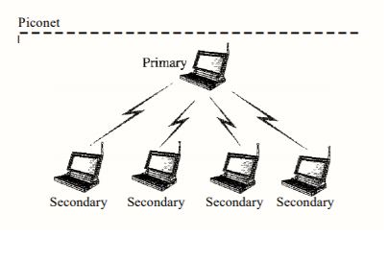
BlueTooth

Slide 5
BlueTooth
SCATERNET : It’s combine of Piconet .
A secondary station in one piconet can be the primary in another
piconet . This station can receive messages from the primary in
the first piconet (as a secondary) and acting as a primary, deliver
them to secondaries in the second piconet. A station can be
a member of two piconets .

Slide 6
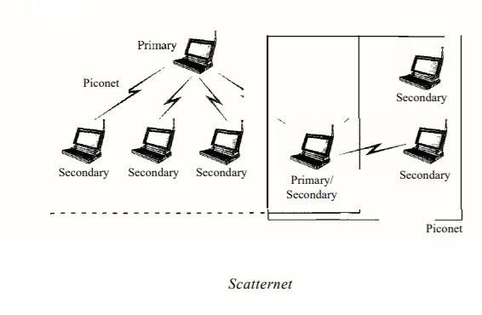
BlueTooth

Slide 7
BlueTooth
BlueTooth Devices Features
The current data rate is 1 Mbps .
Bandwidth 2.4 GHz divided into 79 channels .
There is a possibility of interference between the IEEE 802.11 b wireless LANs and BlueTooth .
Low-Power .
Have range of 10 m .

Slide 8
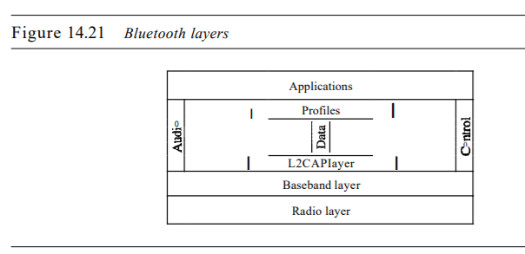
BlueTooth
BlueTooth Layers

Slide 9
BlueTooth
Radio Layer : The radio layer is roughly equivalent to the physical layer of the Internet model .
Band Bluetooth uses a 2.4-GHz ISM band divided into 79 channels of 1 MHz each .
FHSS : Bluetooth uses the frequency-hopping spread spectrum (FHSS) method in the physical layer to avoid interference from other devices or other networks .
Modulation : To transform bits to a signal, Bluetooth uses a sophisticated version of FSK, called GFSK (FSK with Gaussian bandwidth filtering .

Slide 10
BlueTooth
Baseband Layer : The baseband layer is roughly equivalent to the MAC sublayer in LANs .
TDD-TDMA : The access method is TDMA it use by primary and secondary to communicate with each other using time slots.
Physical Links : Two types of links can be created between a primary and a secondary: SCQ links and ACL links .
SCQ A synchronous connection-oriented (SCQ) link is used when avoiding latency (delay in data delivery) is more important than integrity (error-free delivery) .
ACL An asynchronous connectionless link (ACL) is used when data integrity is more important than avoiding latency .

Slide 11
BlueTooth
L2CAP : Logical Link Control and Adaptation Protocol .
equivalent to the LLC sublayer in LANs .
16 bit length .
It’s used for data exchange on an ACL link .

Slide 12
BlueTooth
L2CAP Functions
Multiplexing .
Segmentation and Reassembly .
QoS .
Group Management .
Other Upper Layers : Bluetooth defines several protocols for the upper layers that use the services of L2CAP; these protocols are specific for each purpose .

Slide 13
BlueTooth
Questions
Compare a piconet and a scatternet .
A Bluetooth network is called a piconet. A scatternet is two or more piconets.
Match the layers in Bluetooth and the Internet model .
Radio layer → Internet physical layer .
Baseband layer → MAC sublayer of Internet data link layer .
L2CAP layer → LLC sublayer of Internet data link layer .

Slide 14
BlueTooth
Questions
What are the two types of links between a Bluetooth primary and a Bluetooth secondary ?
A Bluetooth primary and secondary can be connected by a synchronous connection-oriented (SCO) link or an asynchronous connectionless (ACL) link.
An SCO link is used when avoiding latency (delay in data delivery) is more important than integrity (error-free delivery). An ACL link is used when data integrity is more important than avoiding latency.

Slide 15
BlueTooth
Questions
In multiple-secondary communication, who uses the even-numbered slots and who uses the odd-numbered slots ?
The primary sends on the even-numbered slots , the secondary sends on the odd numbered slots.
How much time in a Bluetooth one-slot frame is used for the hopping mechanism ? What about a three-slot frame and a five-slot frame ?
In all types of frames, a duration of 259 μs is used for hopping .

Slide 16
Done …
Msc. Mustafa Abbas A.Al-Khafaji
Atilim University
2018

