Slide 1
Transmission Media
Wired , Wireless

Slide 2
Transmission Media
Transmission media are actually located below the physical layer and are directly controlled by the physical layer .

Slide 3
Transmission Media
Medium : can be broadly defined as anything that can carry information from a source to a destination .
The transmission medium is usually free space, metallic cable, or fiber-optic cable .
The information is usually a signal that is the result of a conversion of data from another form .
Wireless communication started in 1895 when Hertz was able to send high frequency signals .

Slide 4
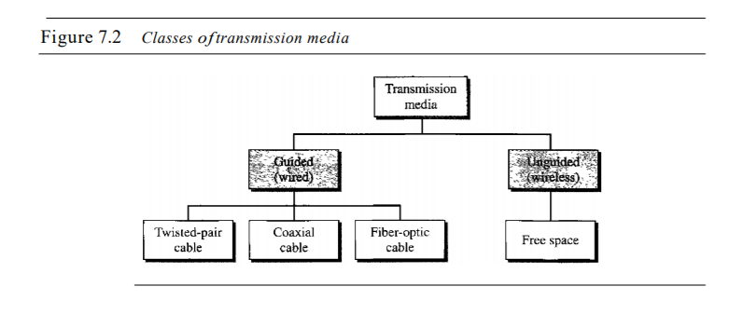
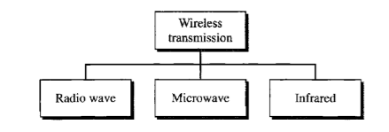
Transmission Media

Slide 5
Guided Media
Guided media, which are those that provide a conduit from one device to another, include twisted-pair cable, coaxial cable, and fiber-optic cable .
Twisted-pair and coaxial cable use metallic (copper) conductors that accept and transport signals in the form of electric current .
Optical fiber is a cable that accepts and transports signals in the form of light .

Slide 6
Twisted-Pair
A twisted pair consists of two conductors (normally copper), each with its own plastic insulation, twisted together .
One of the wires is used to carry signals to the receiver, and the other is used only as a ground reference .

Slide 7
UTP AND STP
Unshielded twisted-pair : The most common twisted-pair cable used in communications .
shielded twisted-pair : Its a version of twisted-pair cable produced by IBM for its use .
STP has a metal casing improves the quality of cable by preventing the penetration of noise or crosstalk, it is bulkier and more expensive .
STP is seldom used outside of IBM .

Slide 8
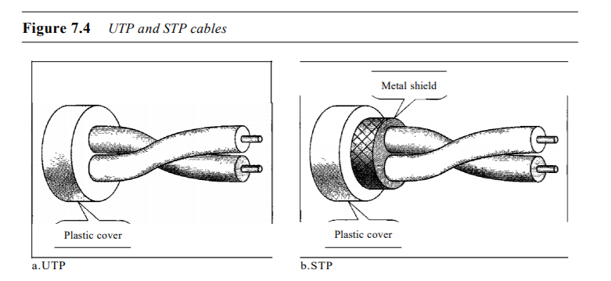
UTP AND STP

Slide 9
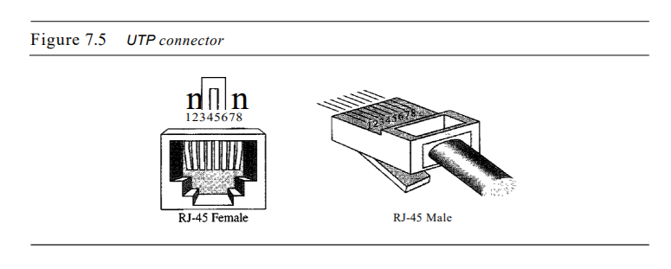
Connectors
The most common UTP connector is RJ45 (RJ stands for registered jack) .

Slide 10
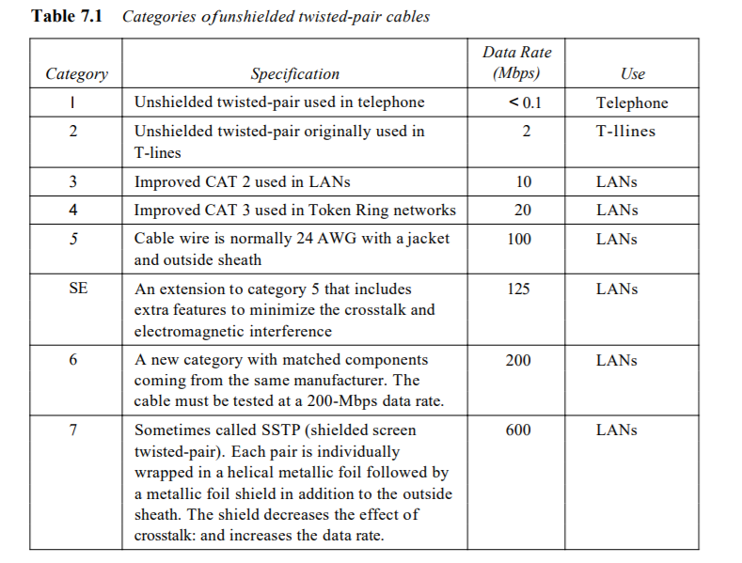
Categories of UTP

Slide 11
Twisted-Pair
Applications
Telephone lines to provide voice and data channels .
The DSL lines that are used to provide high-data-rate connections .
Local-area networks, such as lOBase-T and lOOBase-T .

Slide 12
Coaxial
carries signals of higher frequency ranges than those in twisted- -pair cable .
coax has a central core conductor of solid or stranded wire (usually copper) enclosed in an insulating sheath , which is in turn, encased in an outer conductor of metal foil, braid, or a combination of the two. The outer metallic wrapping serves both as a shield against noise and as the second conductor, which completes the circuit. This outer conductor is also enclosed in an insulating sheath, and the whole cable is protected by a plastic cover .

Slide 13
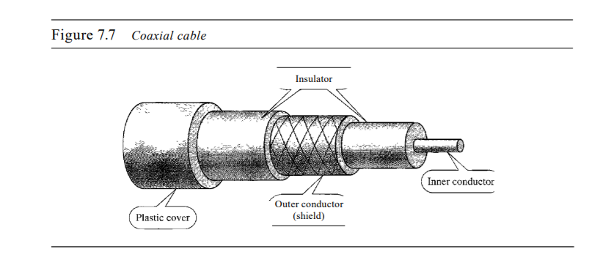
Coaxial

Slide 14
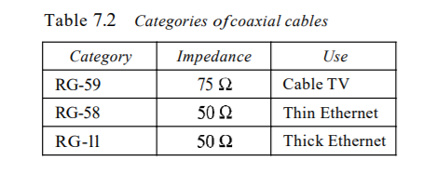
Coaxial Standards
Categorized by their radio government (RG) ratings , Each RG number denotes a unique set of physical specifications including
the wire gauge of the inner conductor .
the thickness and type of the inner insulator .
the construction of the shield .
the size and type of the outer casing .

Slide 15
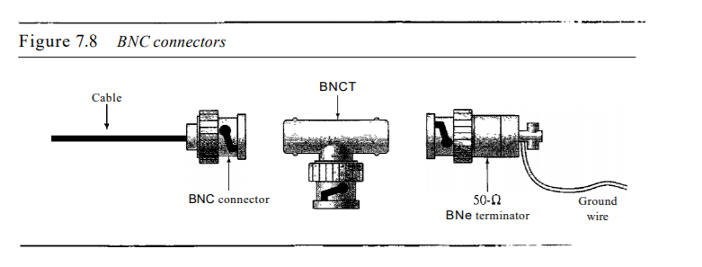
Connectors
The BNC connector is used to connect the end of the cable to a device, such as a TV set .
The BNC T connector is used in Ethernet networks to branch out to a connection to a computer or other device.
The BNC terminator is used at the end of the cable to prevent the reflection of the signal .
The most common type is BNe .

Slide 16
Coaxial
Applications
Analog and digital telephone networks .
Cable TV networks .
Hybrid networks .
Traditional Ethernet LANs .

Slide 17
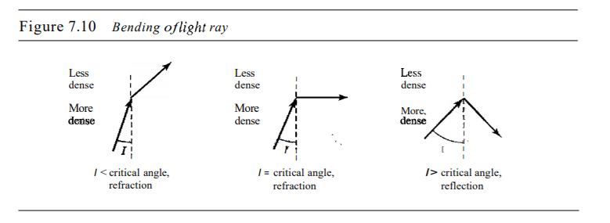
Fiber-Optic
Its made of glass or plastic & transmits signals in the form of light.
If the angle of incidence I (the angle the ray makes with the line perpendicular to the interface between the two substances) is less than the critical angle, the ray refracts and moves closer to the surface.
If the angle of incidence is equal to the critical angle, the light bends along the interface .
If the angle is greater than the critical angle, the ray reflects (makes a turn) and travels again in the denser substance .

Slide 18
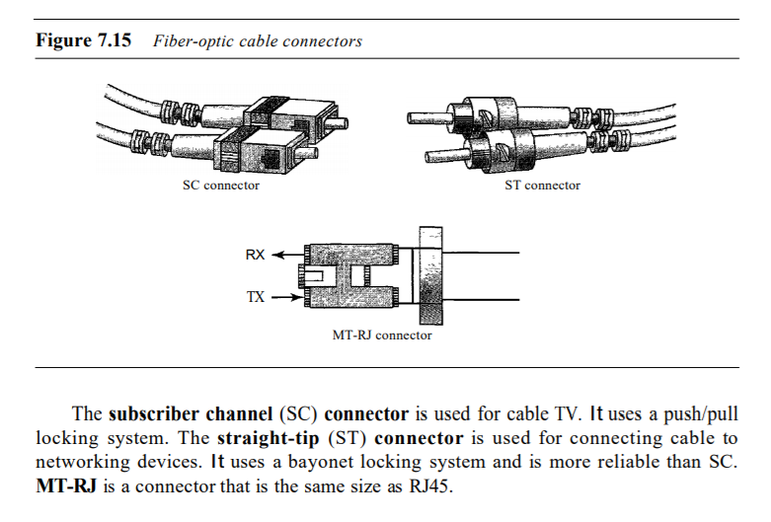
Connectors

Slide 19
Fiber-Optic
Applications
Often used in backbone networks .
Some cable TV companies use a combination of optical fiber and coaxial cable, thus creating a hybrid network .
Local-area networks such as 100Base-FX network and1000Base-X

Slide 20
Fiber-Optic
Advantage
Higher bandwidth .
Less signal attenuation .
Immunity to electromagnetic interference .
Resistance to corrosive materials .
Light weight .
Greater immunity to tapping .

Slide 21
Fiber-Optic
Disadvantages
Installation and maintenance .
Unidirectional light propagation .
Cost .

Slide 22
Infrared
Frequency range from 300 GHz – 400 GHz .
wave length 1 mm – 770 nm .
used for short-range communication .
useless for long – range communication .
cannot penetrate walls .
The characteristic prevent the interference between one system and other .
we cannot use infrared waves outside a building because the sun's rays contain infrared waves that can interfere with the communication .

Slide 23
Infrared
Applications
Keyboards .
Mice .
PCs .
Printers .
A data rate of 75 kbps for a distance up to 8 m.
The recent standard defines a data rate of 4 Mbps

Slide 24
Done …
Msc. Mustafa Abbas A.Al-Khafaji
Atilim University
2018

