Slide 1
للتدريب وتقنية المعلومات
Facebook.com/SAHLtraining
ENG.TAMER ZEIN
Twitter.com/SAHLtraining
it.tamer.zein@gmail.com
Sahltraining.com

Slide 2
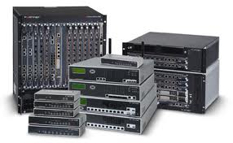
Arabic Video Fort iGATE-VM
Sahltraining.com

Slide 3
Presented to :
IT Professional`s
Network Administrator`s
Information Security Engineer`s
New IT Student`s
مقدم لــــ
متخصصي مجال تقنية المعلومات
مديري الشبكات والانظمة
مهندسي أمن المعلومات
طلاب الجامعات والدارسين الجدد لمجال تقنية المعلومات
Sahltraining.com

Slide 4
Fortinet Company تعريف بالشركة
1- شركة امريكية متخصصة فى مجال امن المعلومات والشبكات ، تأسست عام 2000 بواسطة
Ken Xie المؤسس والرئيس التنفيذي السابق لشركة NetScreen ، وهي شركة عالمية
مقرها الرئيسي فى سانيفيل بكاليفورنيا
Fortinet is an American company that specializes in Network Security appliances , Fortinet was founded in 2000 by Ken Xie , the founder and former president and CEO of NetScreen , Fortinet is an international company, headquartered in Sunnyvale, California.
2- وتعتبر الرائدة فى المبيعات في سوق UTM
Fortinet's position as the revenue leader in Unified Threat Management (UTM)
3- وتعتمد في نظام المبيعات على الممثلين او الشركاء فى حوالى 1500 مكان لها حول العالم .
Fortinet distributes its systems and subscription-based services using the Channel Partner sales method, having over 1,500 worldwide.
Sahltraining.com

Slide 5
FortiGate® Network Security Platform
FortiAnalyzer Centralized Network Security Reporting
FortiManager Centralized Security Management
FortiMail™ Email Security Appliances
FortiDB Database Security and Compliance
FortiWeb Web Application Security
FortiClient Endpoint Security Management
FortiSwitch Ethernet Access & Data Center Switches
Sahltraining.com

Slide 6
Certifications الشهادات
(FCNSA) المستوى الاول : مدير أمن لشبكات الفورتي جيت
Fortinet Certified Network Security Administrator
Exam Price: $150
configuration and monitoring of FortiGATE devices as well as a general understanding of the entire Fortinet product family of services and hardware
manage the day-to-day operations of FortiGATE devices
(FCNSP) المستوى المتقدم : محترف أمن لشبكات الفورتي جيت
Fortinet Certified Network Security Professional
Exam Price: $250
installation and configuration of all FortiGATE features and functionality such as HA and redundant VPNs
Sahltraining.com

Slide 7
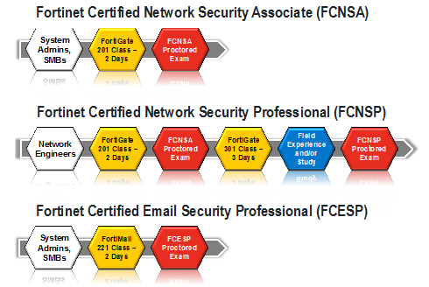
(FCESP)محترف أمن حلول البريد الالكتروني والتراسل
Fortinet Certified Email Security Professional
Exam Price: $150
implement and deploy standards-based technologies such as SMTPS
Sahltraining.com

Slide 8
FortiGATE UTM Conceptمفهوم عن انظمة إدارة الحماية الموحدة
FortiGATE is a UTM unified threat management
UTM Is a New technology start in 2005
Firewall before UTM
FortiGATE UTM act as 6 Roles
1-Router
2– Firewall
3– Anti virus
4– Anti Spam
5- Web Filtering
6- IPS
Sahltraining.com

Slide 9
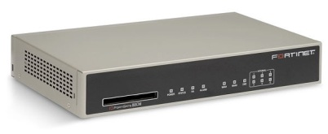
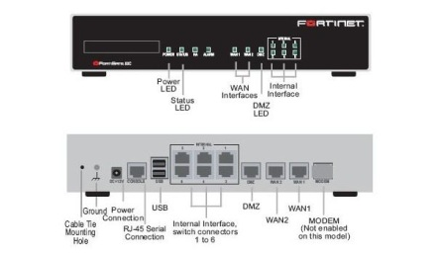
FortiGATE view
Sahltraining.com

Slide 10
Fort iGATE Series
1- High-End
FortiGate-5000 series
FortiGate-3700D
2- Mid-Range
FortiGate-1000C
FortiGate-100D Series built-in wireless controller, integrated switching (POE)
3- Desktop
FortiGate-90D/FortiWifi-90D Series
FortiGate-80C
http://www.fortinet.com/products/fortigate
Sahltraining.com

Slide 11
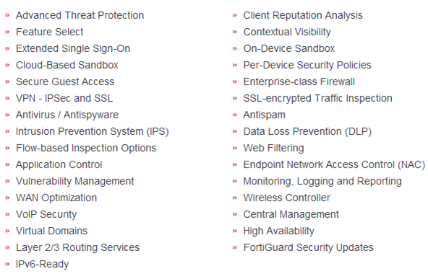
FortiOS key feature
Sahltraining.com

Slide 12
Lab Design
Internet
192.168.15.1/24
External
Bridge
Internal
VMnet 4
ADSL
192.168.1.10/24
VMware
WAN 192.168.15.100/24
LAN 192.168.1.99/24
DMZ
VMnet 8
10.0.0.1/24
Sahltraining.com

Slide 13
Prerequisite's
Knowledge of VMware WorkStation
knowledge of Network Security Field
Tools
VMware WorkStation 7.0
Fortinet VM images
http://www.mediafire.com/download/k73q2t8m43s9gt9/FortiGate-VM.rar
Sahltraining.com

Slide 14
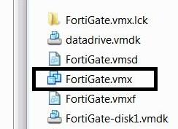
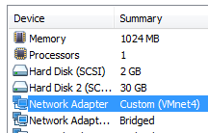
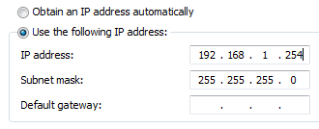
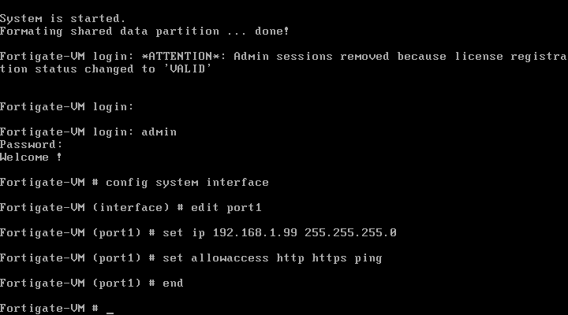
Step 1
-1-
-2-
-3-
-4-
Sahltraining.com

Slide 15
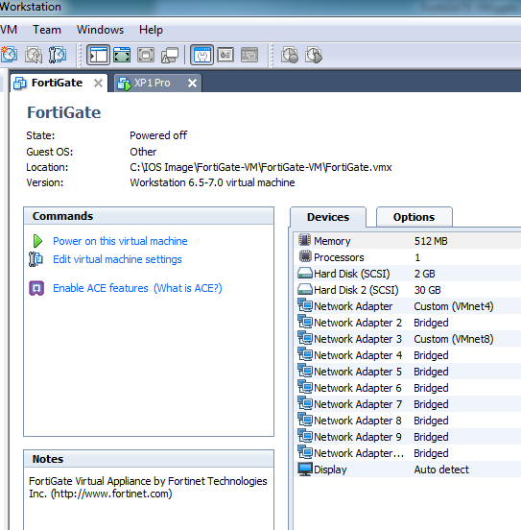
Step 2(VMware)
Win XP
Install New Windows XP 32 bit Image
& Disable Windows Firewall
Assign TCP/IP 192.168.1.10/24 (VMnet 4 )
Fort iGATE-VM
Connect first NIC to VMnet 4 192.168.1.99/24 Internal
Connect Second NIC to Bridge 192.168.100.1/24 External
Connect third NIC to VMnet 8 10.0.0.1/24 DMZ
Sahltraining.com

Slide 16
Step 3 UTM Access Internet
Fort iGATE access Internet
Activate Ports
Ping to Yahoo.com ( no ping )
Configure DNS
Configure Static Route & Test Ping to Yahoo.com
Sahltraining.com

Slide 17
THANK YOU!
TAMER ZEIN
https://www.youtube.com/SAHLtraining
https://www.facebook.com/SAHLtraining
https://twitter.com/SAHLtraining
http://www.kutub.info/library
شاهد الفيديو
https://www.youtube.com/watch?v=K-hWuTtR1UA
Soon www.SAHLtraining.com
Sahltraining.com

